Slide 2


Bootcamp 2024
Carlos Valle (cgvalle@uc.cl)
Jorge González (jfgonzalez5@uc.cl)
January, 2022

Slide 3
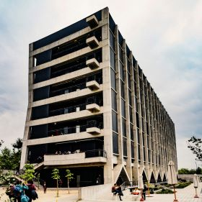
Welcome to the IIBM !!
Notes:
Carlos

Slide 4
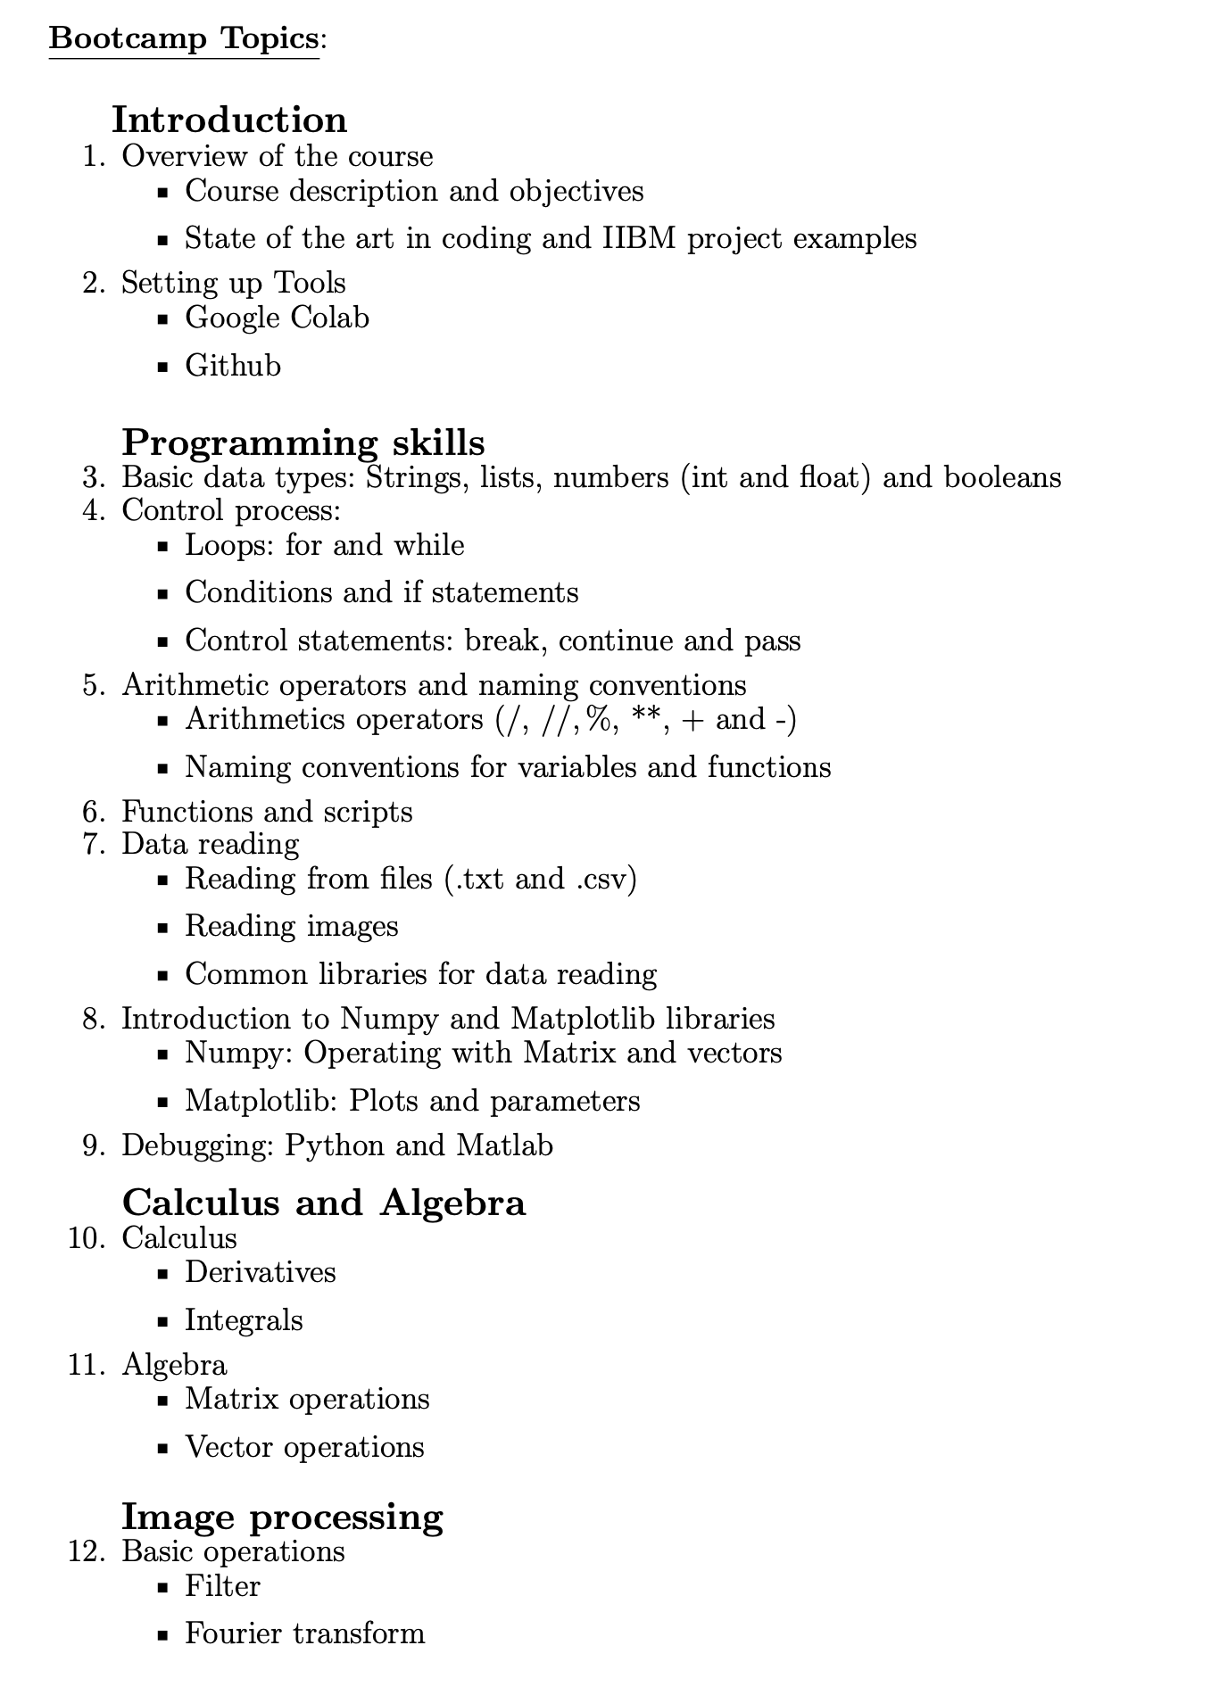


Notes:
Carlos: Esto les sera util para sus cursos de postgrado.

Slide 5
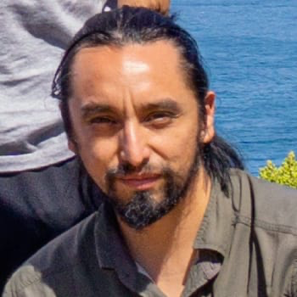
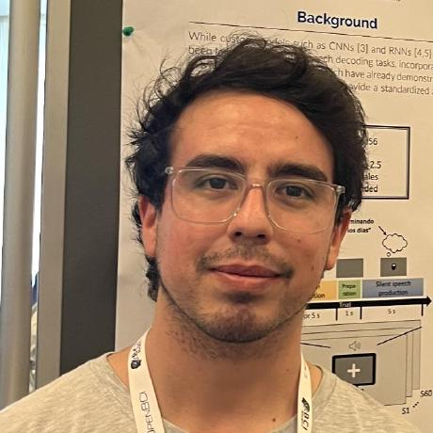
Hello !
Carlos Valle Araya, PhD.
IIBM Postgraduate student, 2019 generation
Thesis: ‘Improving Brain-to-Text Models Utilizing Recurrent Neural Networks and Transfer Learning for Neuroprosthetic Speech’
Jorge González, PhD Student.
IIBM Postgraduate student, 2021 generation
Thesis: ‘The connection between dynamic changes in local energy frustation and large rearrangements in non-trivially behaving proteins’
Notes:
AMbos

Slide 6
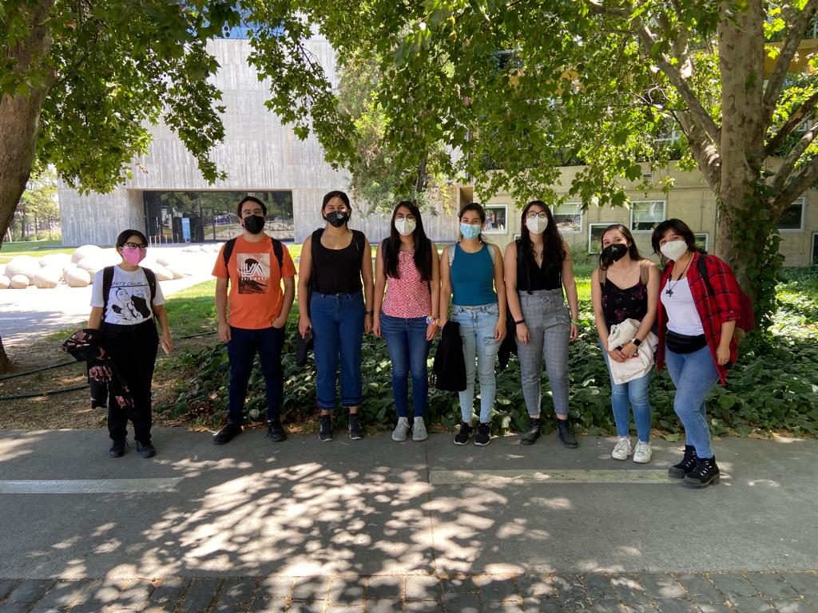
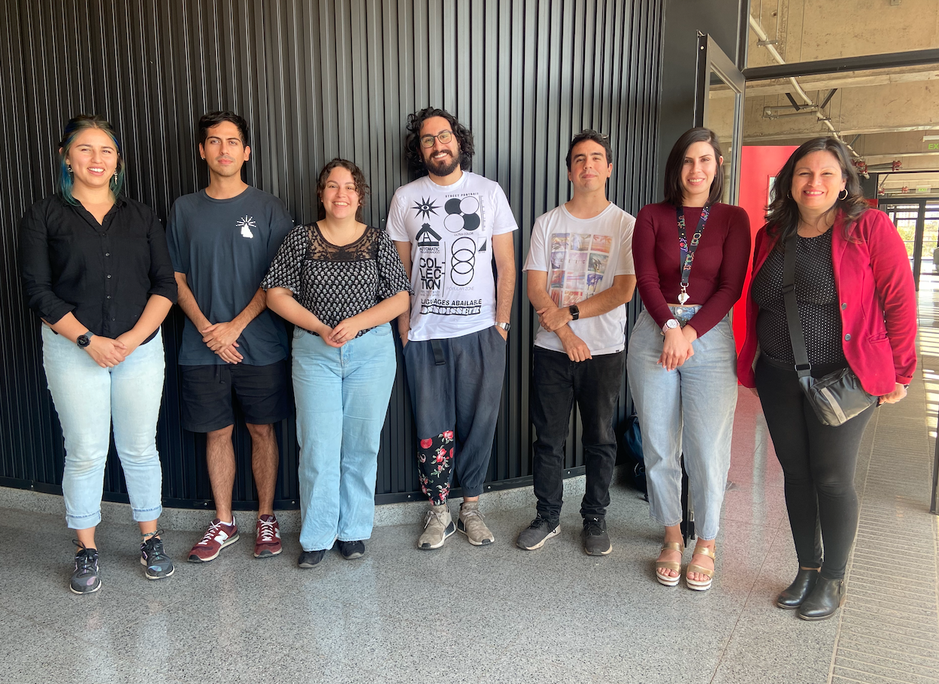
2022
2023

Slide 7
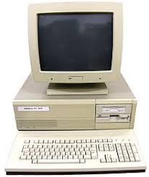

Pre requirements
Notes:
Gaby

Slide 8
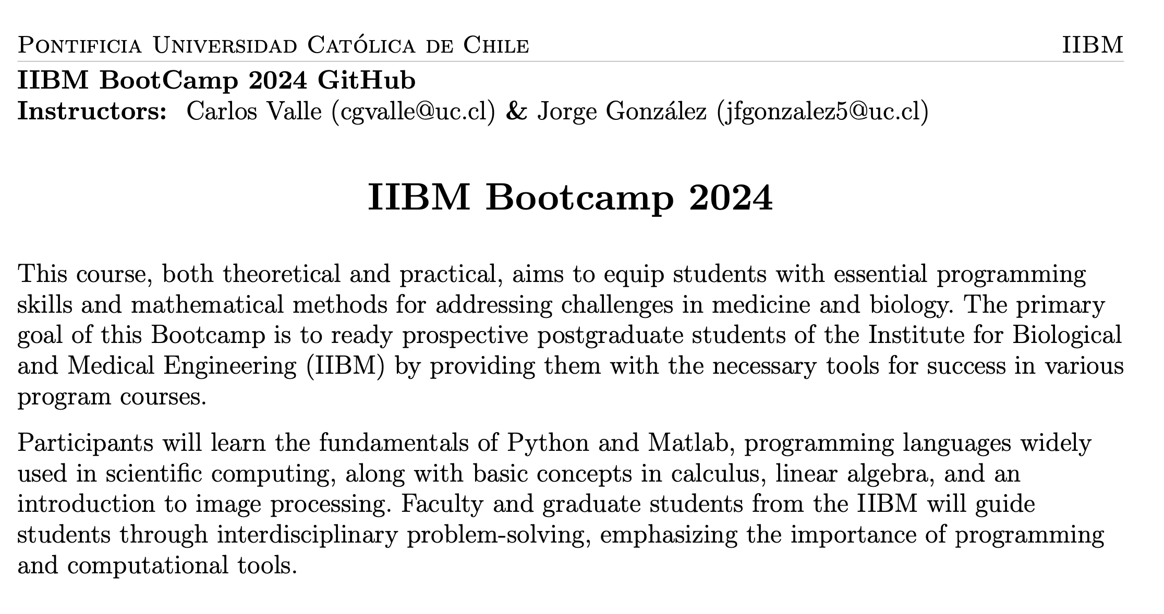
Notes:
Gaby

Slide 9
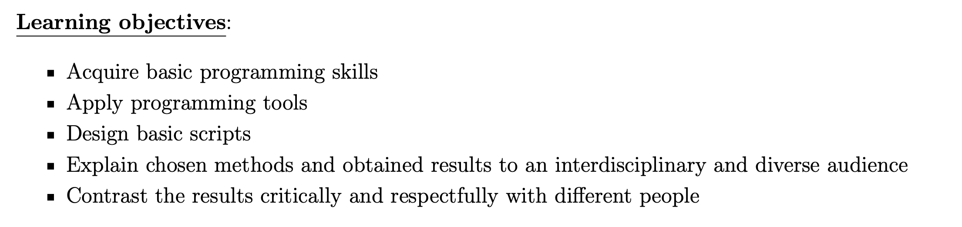
Notes:
Gaby

Slide 10
How it will work?
Notes:
Gaby

Slide 11
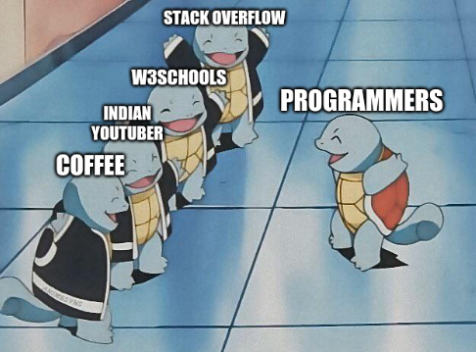
Notes:
AMBOS: Darles motivación, decir que depende de su trabajo. Y que como indian youtuber nos tienen a nosotros. Fomentar la ayuda entre ellos

Slide 12
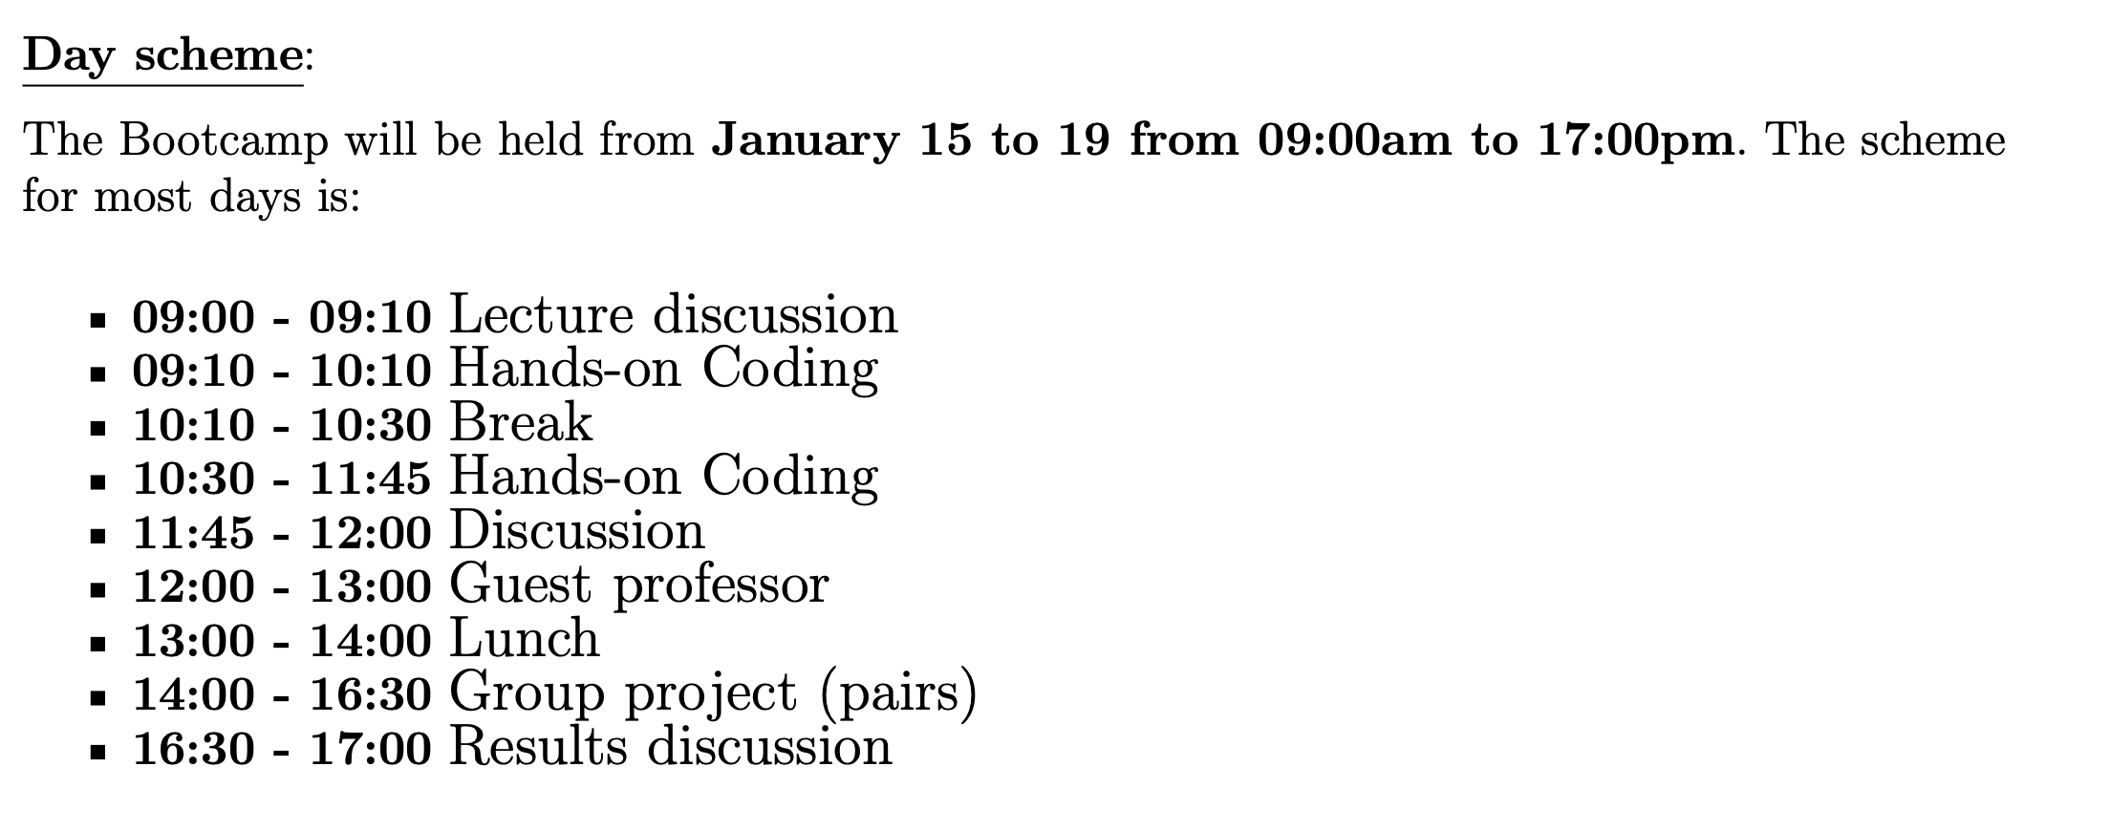
Notes:
Carlos

Slide 13
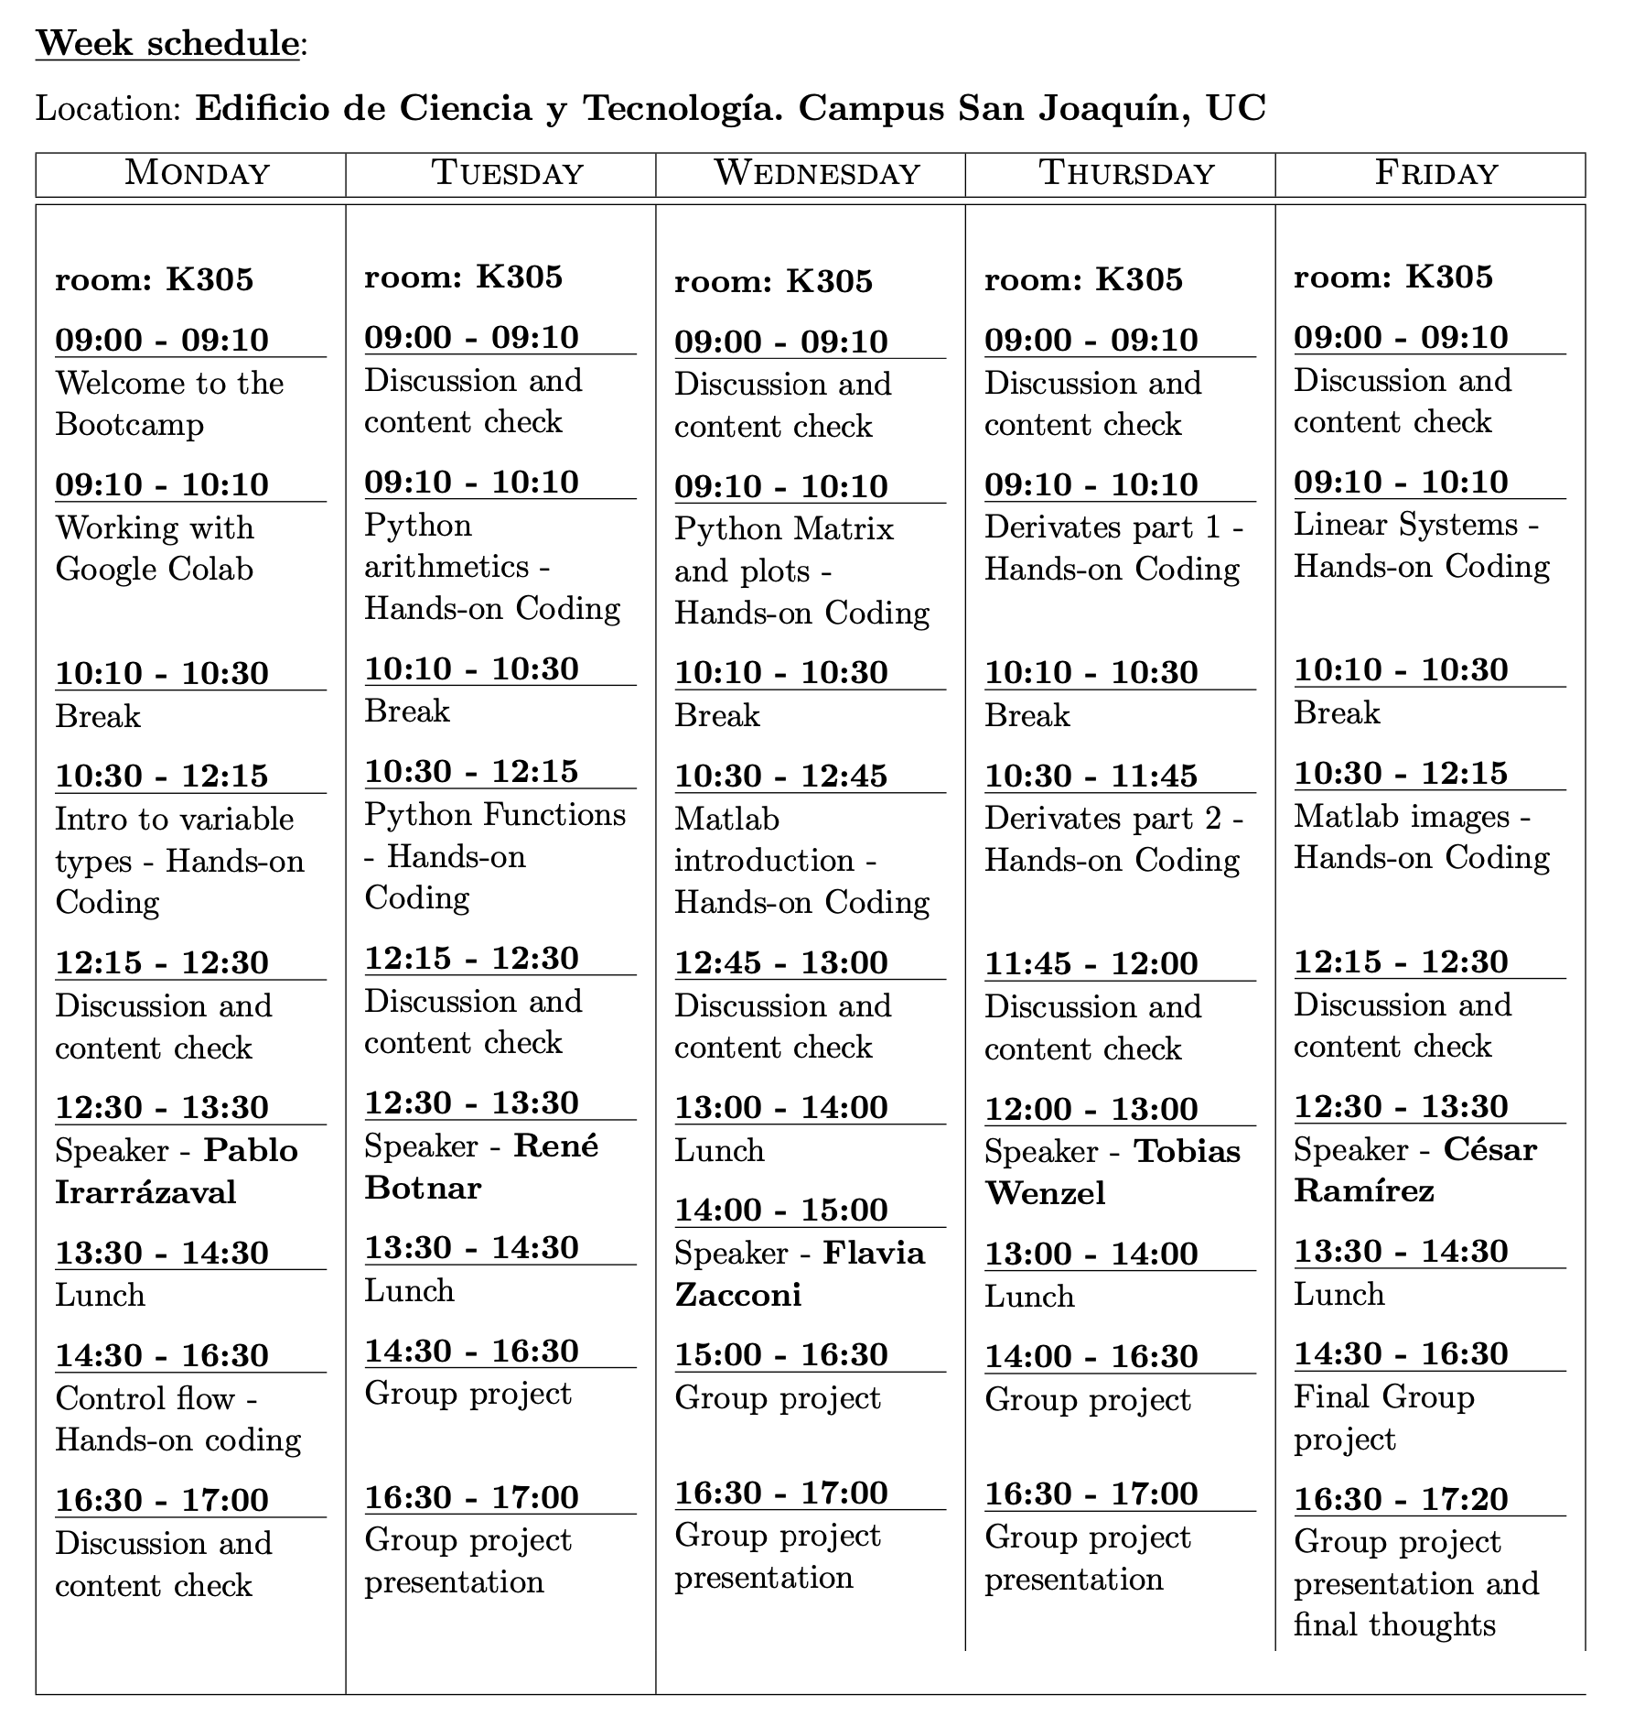
Notes:
Carlos

Slide 14
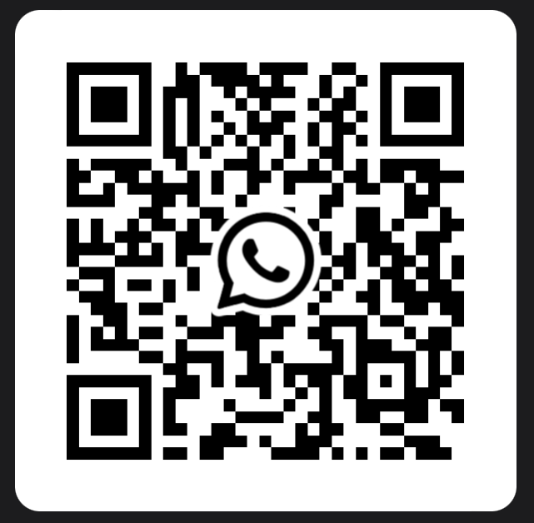
Whatsapp Group
Notes:
Carlos

Slide 15
Evaluation
No grades. But you must send your work of every day to the link that will be at the end of the documents of each session
Notes:
Carlos

Slide 16
iHEALTH_2023

